Slide 1


Safe Reinforcement Learning for Start-up and Operation of Chemical Processes
Dean Brandner | Torben Talis
Technische Universität Dortmund | Technische Universität Berlin
 | SPP2331 PhD Workshop – Berlin
 | 29.03.2023
Notes:
Gerne auf Zeitraum des Projektes hinweisen

Slide 2

Motivation and Approach
Motivation
Start-up/Shutdown of chemical processes
Recipes
Manual adaptations
Model-based control
Model accuracy
Model complexity
Model structure
…
Approach
Use synergies between
Expert knowledge
Model-based control
Reinforcement learning (RL)
Expert knowledge
Reinforcement Learning
Model-based Control
Notes:
or manual adaptations
Model structure: 1. The model can be structurally wrong, 2. The structure is not suited for optimization at all
Develop a systematic approach for development and implementation under real conditions of reinforcement learning (RL) in complex chemical processes to optimize dynamic operation while satisfying process constraints

Slide 3

Reinforced Model Predictive Control
Goal
Optimal control of plant in real time
Not possible due to model structure high model complexity (start-up & shutdown)
Considered Approach
Use MPC with surrogate model
Apply RL to adaptive MPC structure
Pro: Rigorous constraints
Pro: Still interpretable
Pro: Few data need due to good initial starting point for RL
High Fidelity Model/ Real Plant
Data
Surrogate Model
State and Reward
Control
Control
RL
Model
Updates
Updates
$$\text{MPC}\left(θ\right)$$
ANN

Slide 4
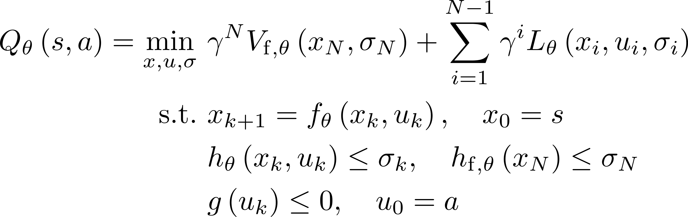
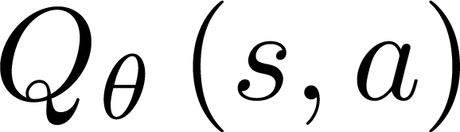
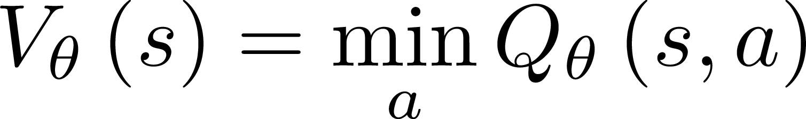
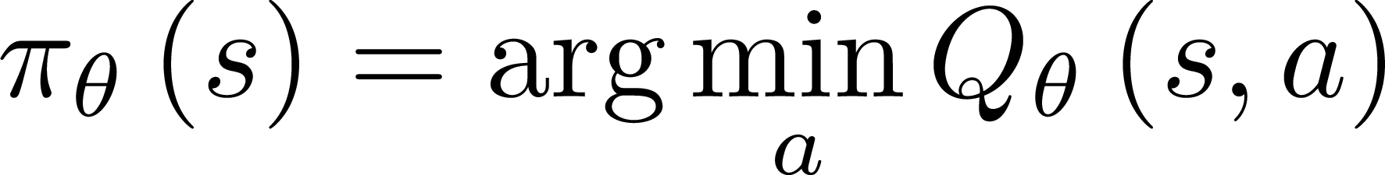

Reinforced Model Predictive Control
Parameterized MPC structure^{[1]}
Approximation of^{[1]}
Action value function
State value function
Policy
High Fidelity Model/ Real Plant
Data
Surrogate Model
State and Reward
Control
RL
Model
Updates
$$\text{MPC}\left(θ\right)$$
S. Gros und M. Zanon, „Data-Driven Economic NMPC Using Reinforcement Learning“, IEEE Trans. Automat. Contr., Feb. 2020.
Notes:
Darauf hinweisen, dass wir auf der Arbeit von den anderen beiden Aufbauen, aber der Unterschied ist, dass wir uns auf reale Systeme konzentrieren wollen. Die Systeme, auf die die das anwenden sind typischer Weise relativ simpel.

Slide 5
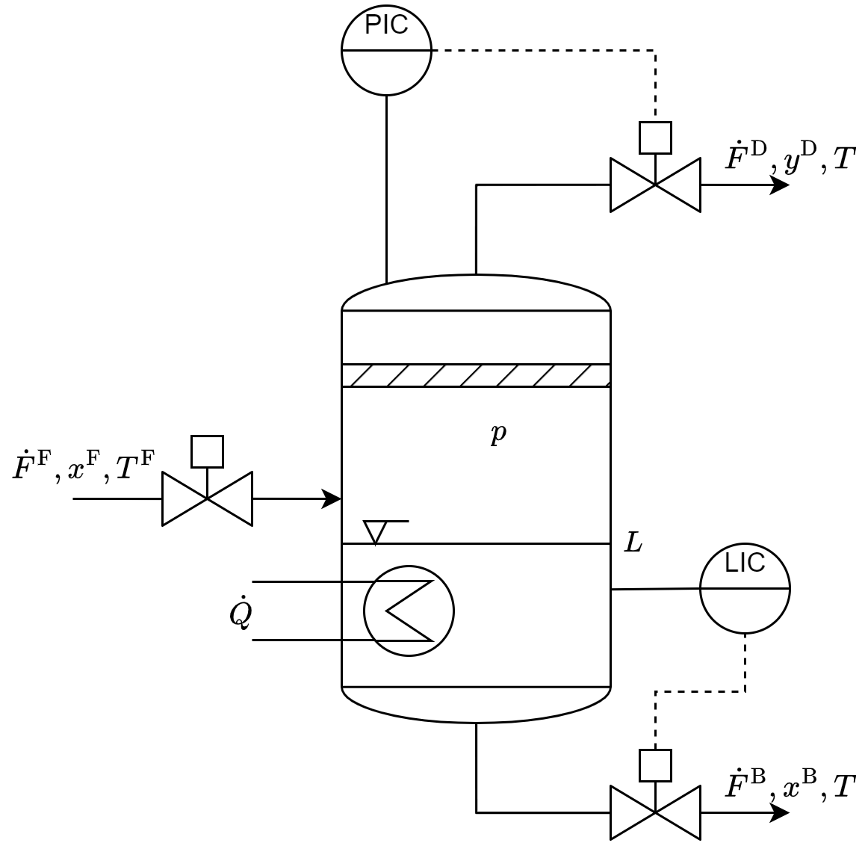
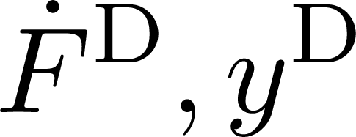
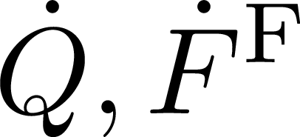
Q-Learning applied to adaptive MPC
Control of flash unit
Complex nonlinear system
5 differential states
41 algebraic states
Tracking of by control of
Compared control MPC methods^{[1]}
High fidelity model and long prediction horizon
Surrogate model and medium prediction horizon
Only terminal cost parameterized
2 control inputs
[Accepted] D. Brandner, T. Talis, E. Esche, J.-U. Repke, und S. Lucia, „Reinforcement learning combined with model predictive control to optimally operate a flash separation unit“, in Proceedings of the 33rd European Symposium on Computer Aided Process Engineering (ESCAPE33), Athens, 2023.
Notes:
Darauf hinweisen, dass wir hier dann das surrogate gebaut haben, um einerseits Komplexität vorzubeugen

Slide 6
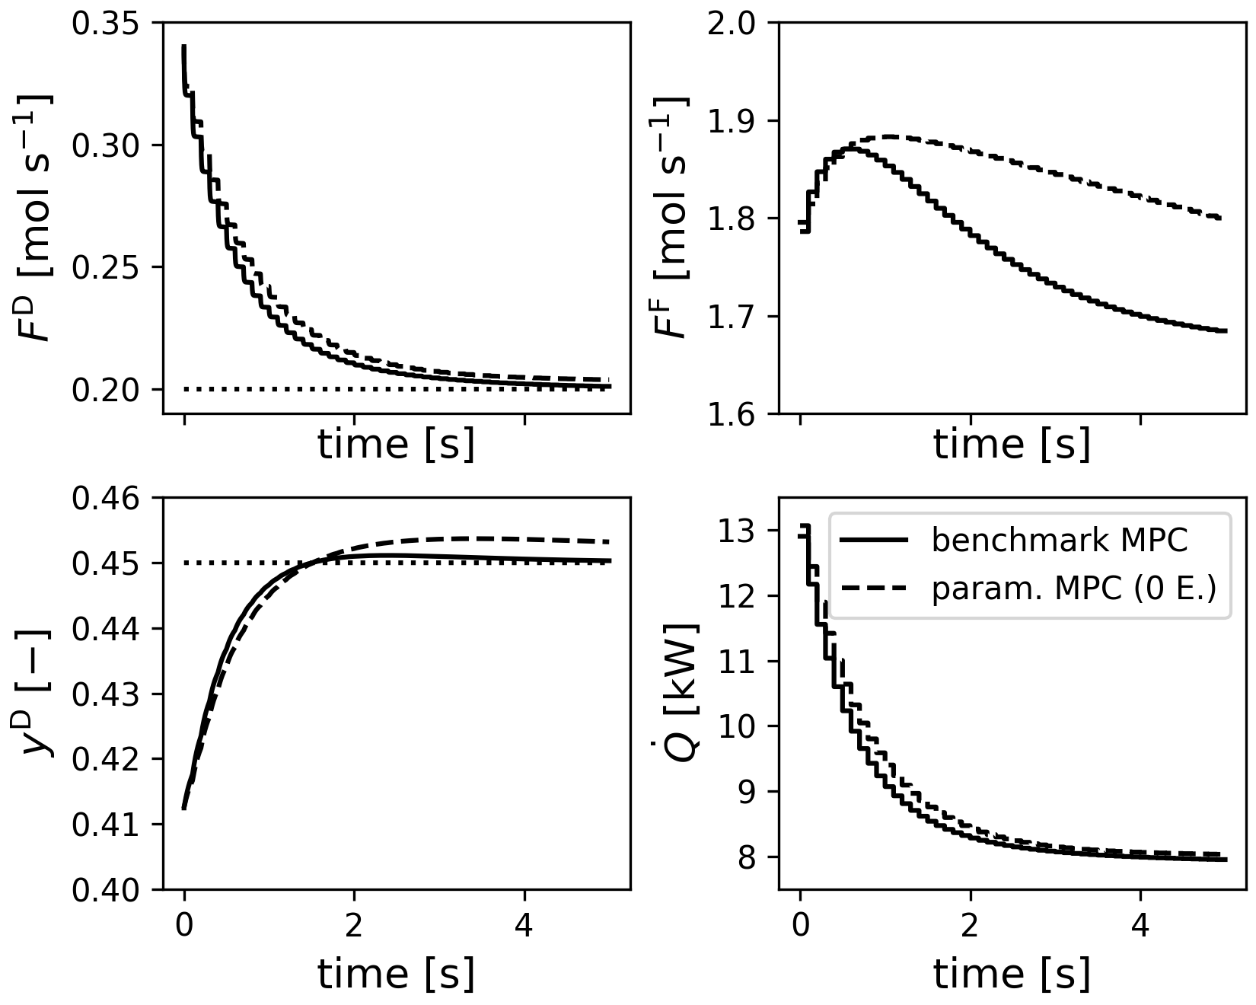
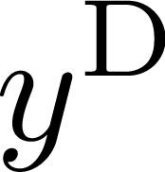
High fidelity MPC vs. Reinforced MPC (start)
No training
Similar to direct application of MPC with surrogate model
cannot be tracked well
Control actions differ as well
Suitable starting point for RL training

Slide 7
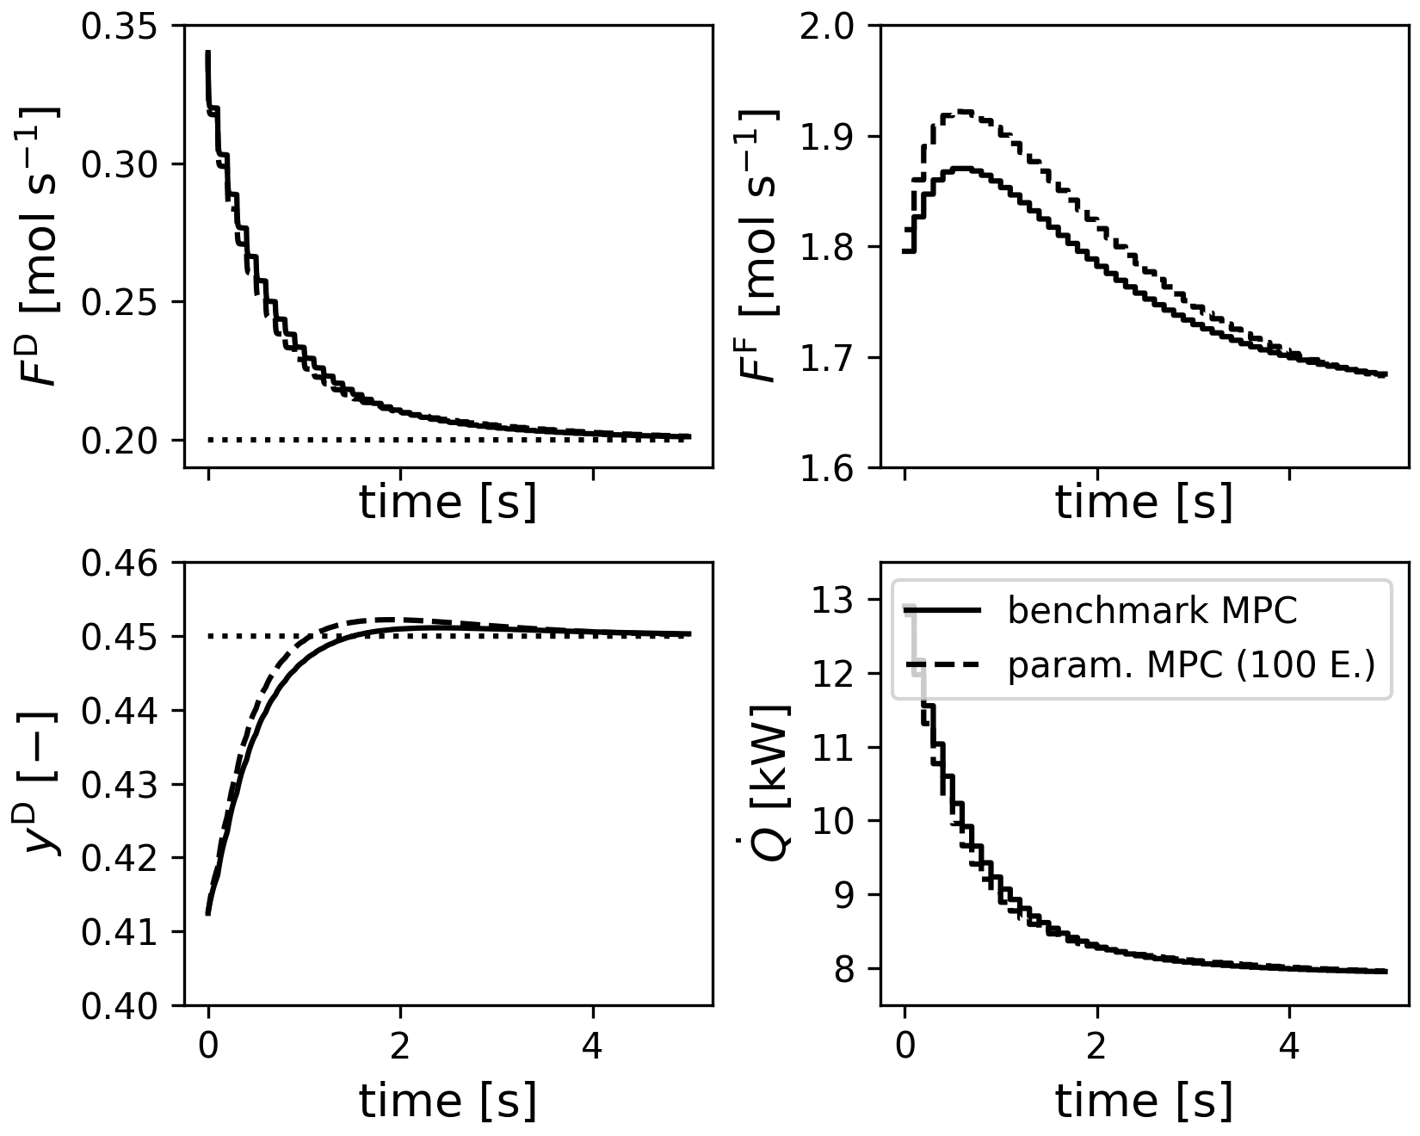
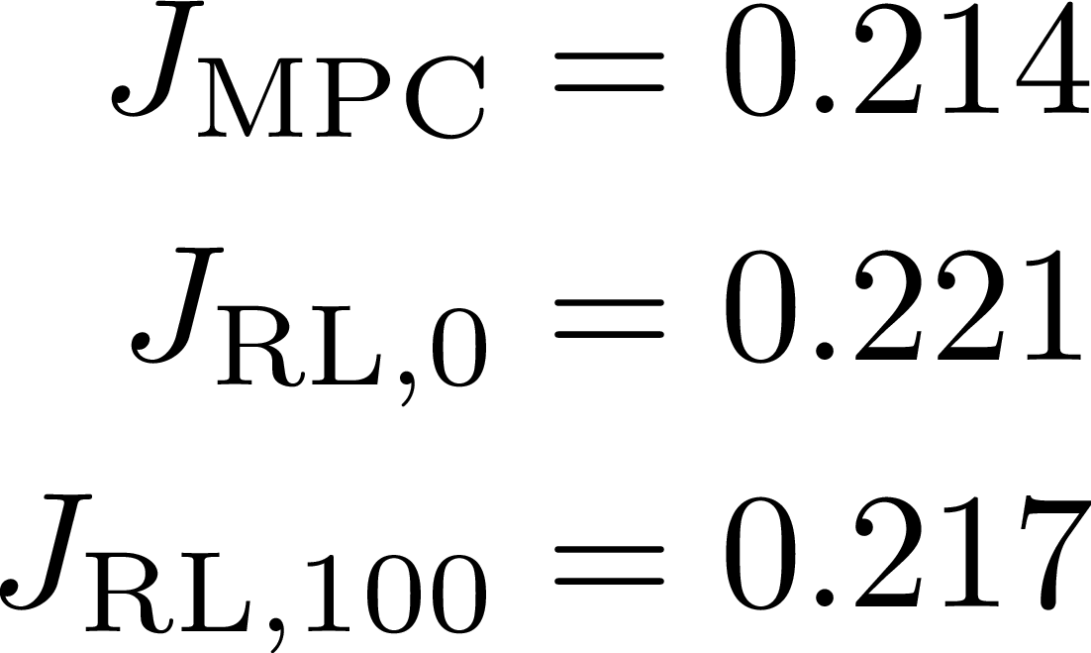
High fidelity MPC vs. Reinforced MPC (trained)
100 Episodes of training
Setpoints are tracked well
Control profiles converge
Closed loop costs:

Slide 8
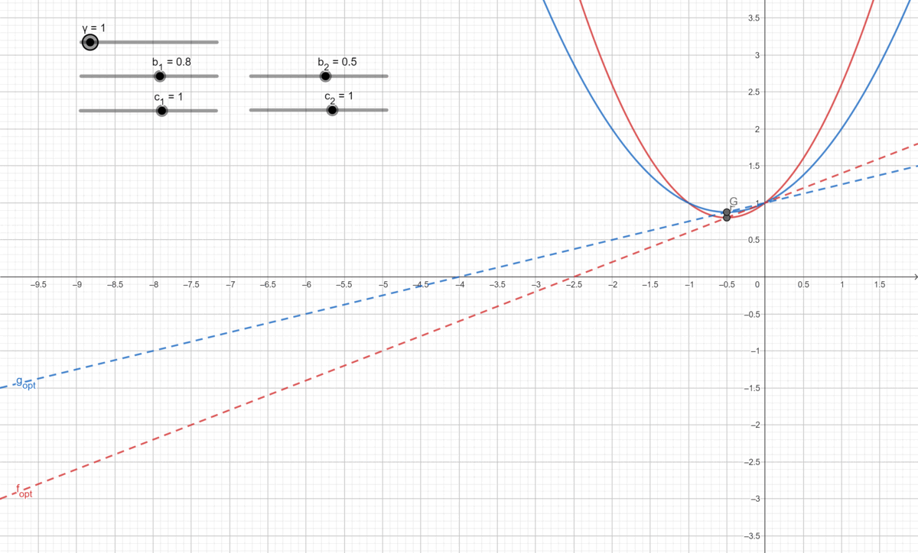
Occuring Challenges
Scaling
Factor chosen manually
Very long training for initialization as zero
Q-learning
Mismatch of Q-functions can occur
Training has good starting point
Updates can decrease performance

Slide 9
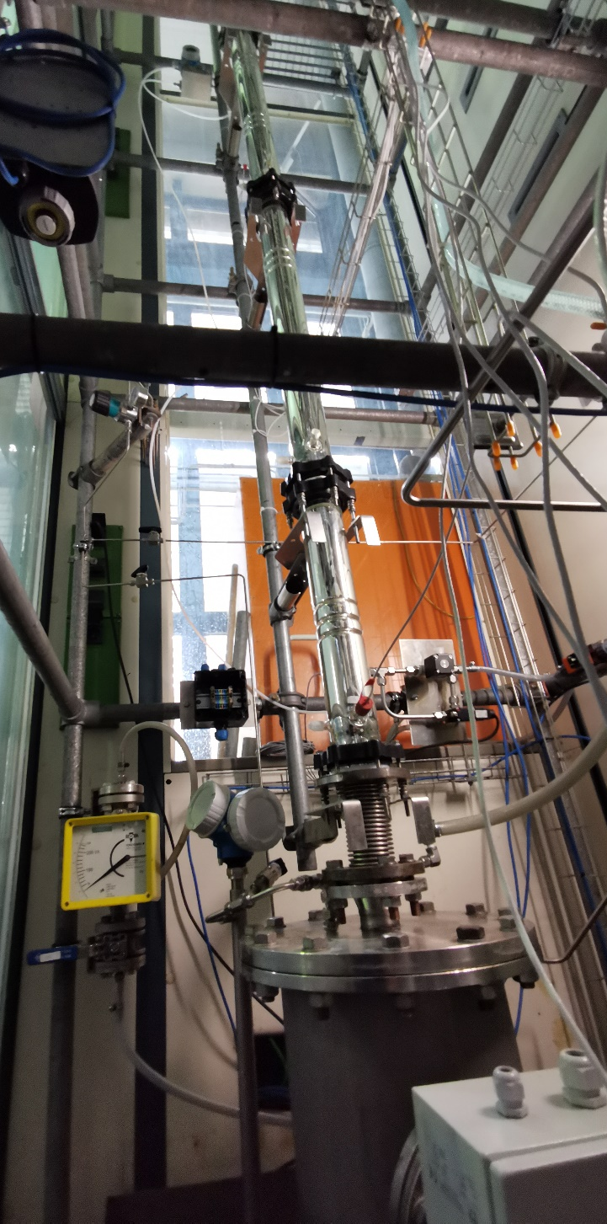
Real-World Application – Batch Distillation
Batch distillation column at TU Berlin – dbta

Slide 10
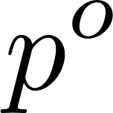
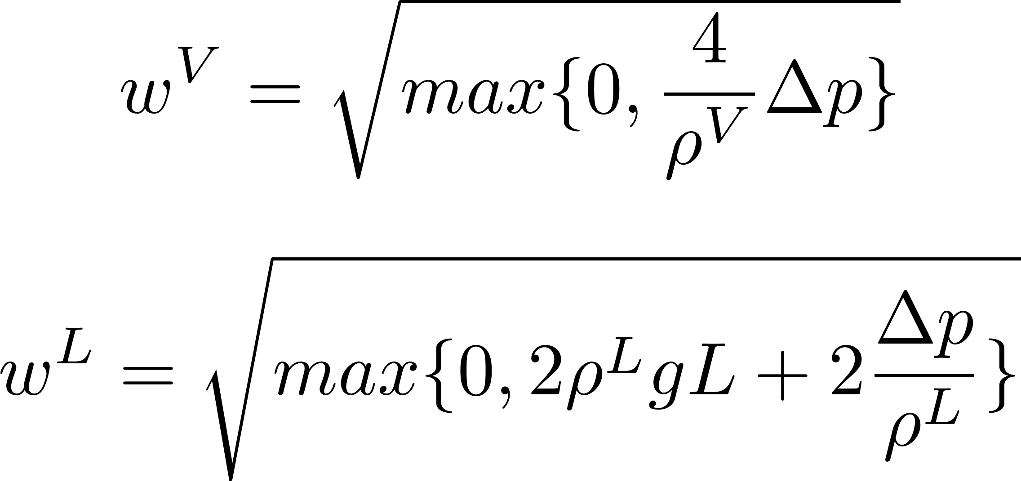

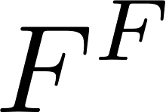
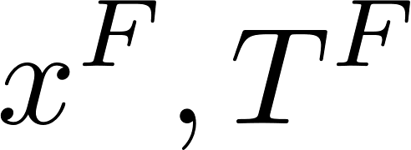

Modelling the reboiler
Fully pressure driven
Disapearing phases
Approximation of all non-smooth functions

Slide 11
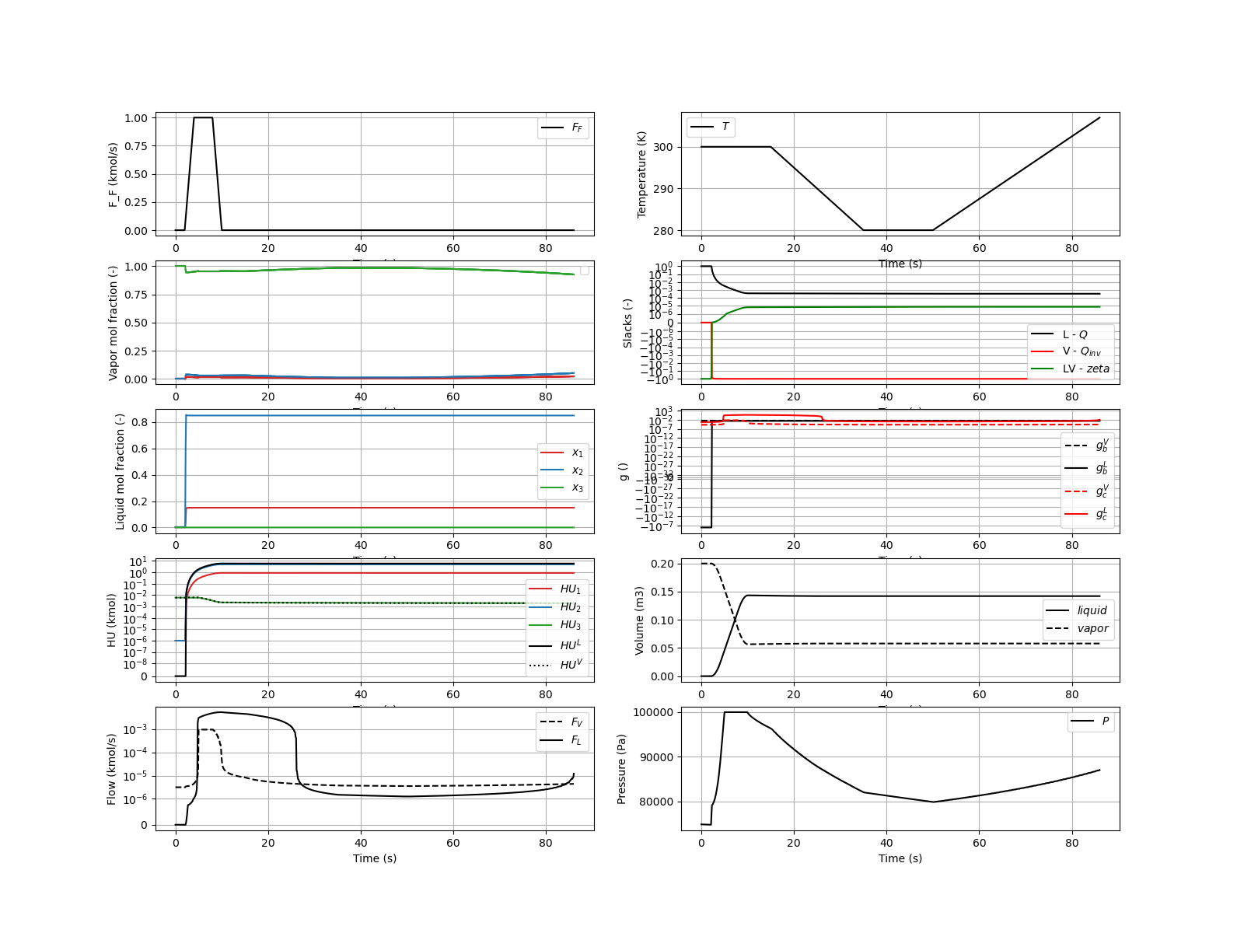
Simulation

Slide 12
Next steps
Scaling of variables and equations
Stack separation units
Introduce more non-idealities
Make it rate-based
…
F
Q

Slide 13
Safe Reinforcement Learning for Start-up and Operation of Chemical Processes
Dean Brandner | Torben Talis
Technische Universität Dortmund | Technische Universität Berlin
 | SPP2331 PhD Workshop – Berlin
 | 29.03.2023
Notes:
Gerne auf Zeitraum des Projektes hinweisen

Slide 14
Backup

Slide 15
Reinforcement Learning for Optimal Control
Goal
Optimal control of plant in real time
Machine Learning Approach
Use classical RL loop
Optimal policy via ANN training
Pro: No prior knowledge required
Main Challenge
Con: Lots of data needed
Con: Lack of interpretability
High Fidelity Model/ Real Plant
State and Reward
Control
RL
Updates
ANN

Slide 16
Model Predictive Control
Goal
Optimal control of plant in real time
Not possible due to model structure high model complexity (start-up & shutdown)
Control-Engineering Approach
Use MPC with surrogate model
Pro: Rigorous constraints
Pro: Interpretability
Main Challenge
Con: Model accuracy, complexity
Con: Controller Tuning
High Fidelity Model/ Real Plant
Data
Surrogate Model
State and Reward
Control
Control
RL
Model
Updates
MPC
ANN
Notes:
Emphasize the structural problems of the HF model the plant may have (if else → Many real simulators have this structure)
Build a surrogate model
Multiple ways possible
Data-driven
Partially data-driven
Model formulated as OP
Pro: Rigorous constraints
Constraints can be considered within the optimization problem
Optimization is interpretable
Cons: Model accuracy
Large effect on consideration of constraints
Stochacity also difficult

Slide 17
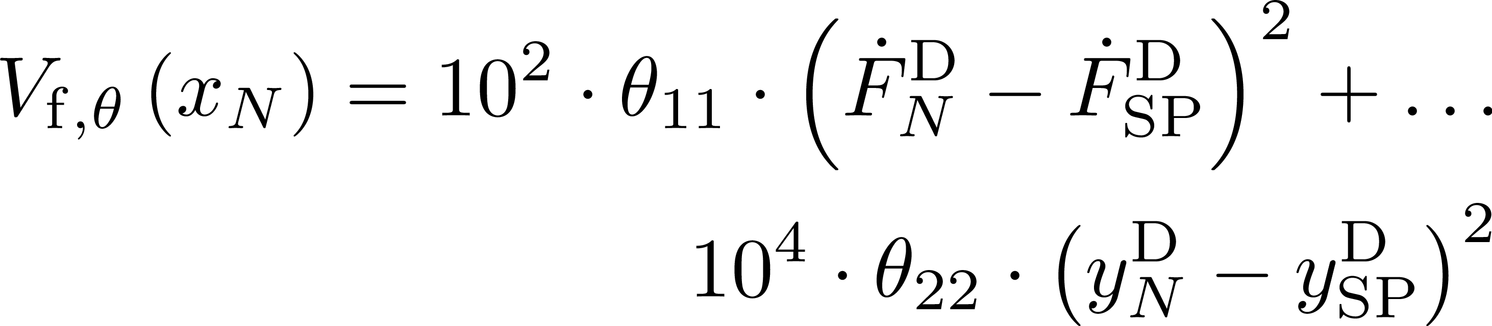
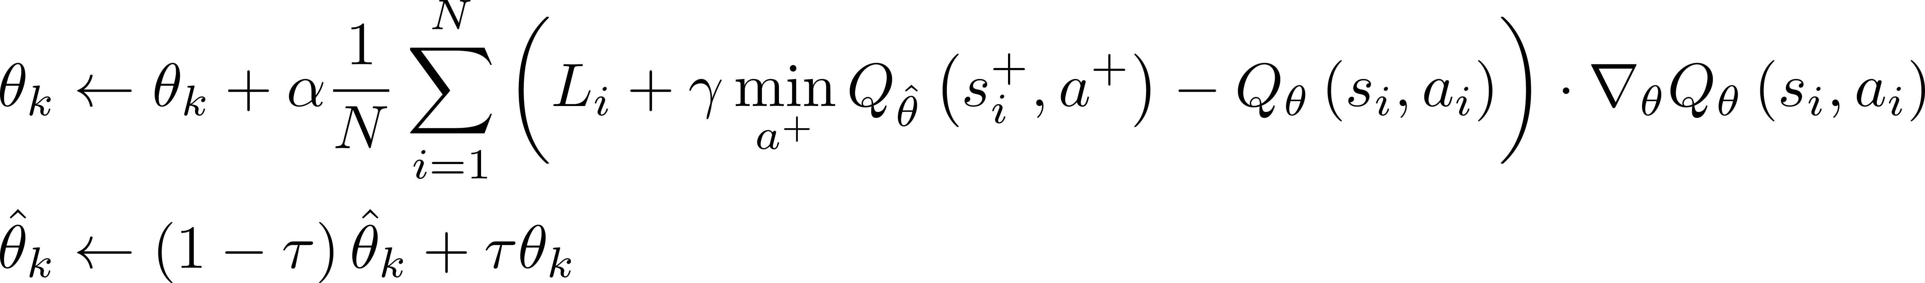
Q-Learning applied to adaptive MPC
Structure of adaptive MPC
Surrogate model is kept unchanged
Only terminal cost parameterized
Q-Learning update
Notes:
Hinzufügen, dass wir mit die Ideen aus ML-Welt kombiniert haben mit der MPC-Parameterisierung
Replay Buffer (minibatch of 16 samples for each update)
Adapted Learning rate (tau = 1, interestingly, alpha = 1e-4)
Target MPC and behaviour MPC (running updates (slower))

Slide 18
Q-Learning applied to adaptive MPC
Structure of adaptive MPC
Surrogate model is kept unchanged
Only terminal cost parameterized
Q-Learning update
Notes:
Hinzufügen, dass wir mit die Ideen aus ML-Welt kombiniert haben mit der MPC-Parameterisierung
Replay Buffer (minibatch of 16 samples for each update)
Adapted Learning rate (tau = 1, interestingly, alpha = 1e-4)
Target MPC and behaviour MPC (running updates (slower))

Slide 19
Conclusion & Outlook
Conclusion
MPC can capture value function and optimal policy
RL can be used to improve parameters of MPC
Investigation of: Replay buffer, Learning rate, target MPC
Outlook
Best RL strategies to update MPC problems in complex cases
Application on actor-critic agents
Start-up and shutdown of batch-distillation column
Notes:
Gros: focus on simple problems

Slide 20
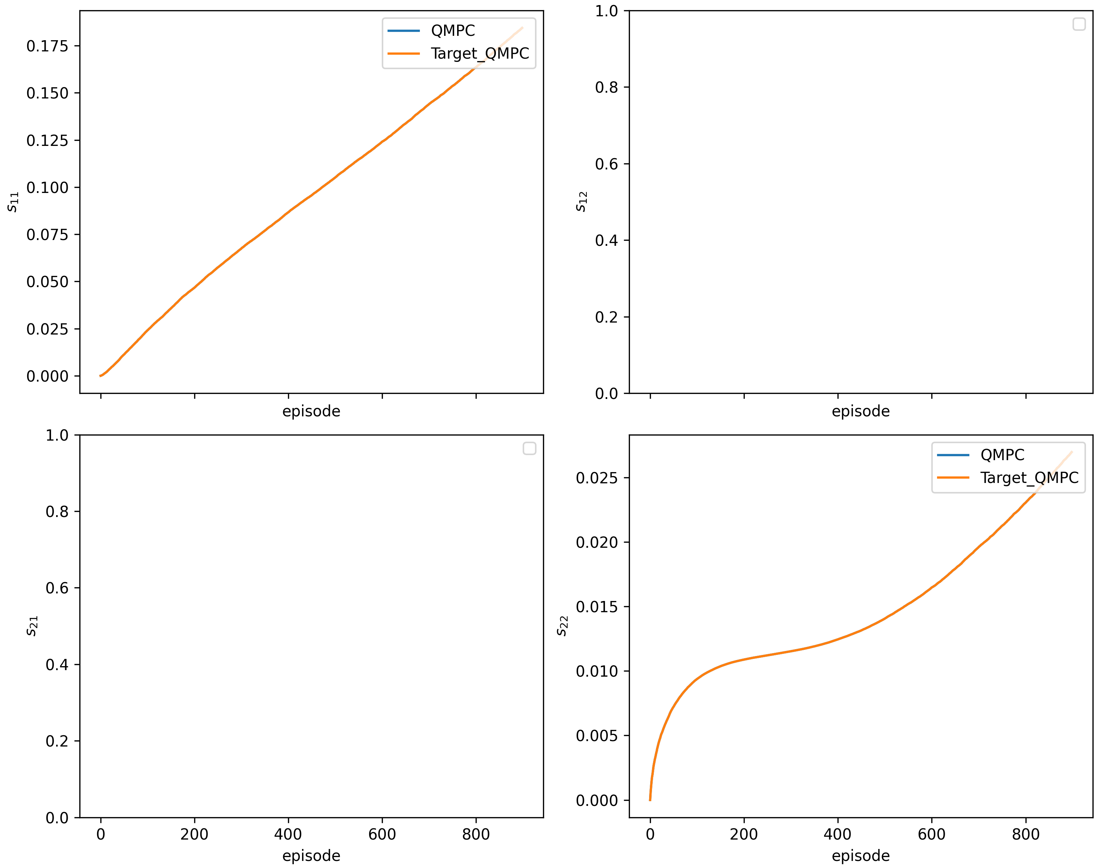
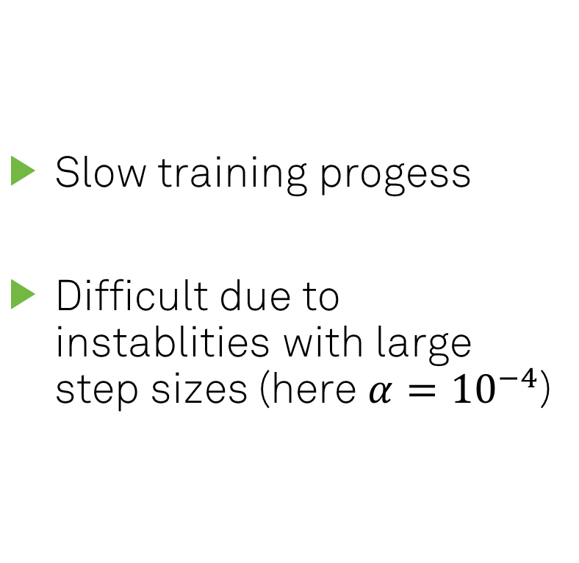
Training of parameters
Slow training progess
Difficult due to instablities with large step sizes (here $α={10}^{−4}$)

Slide 21
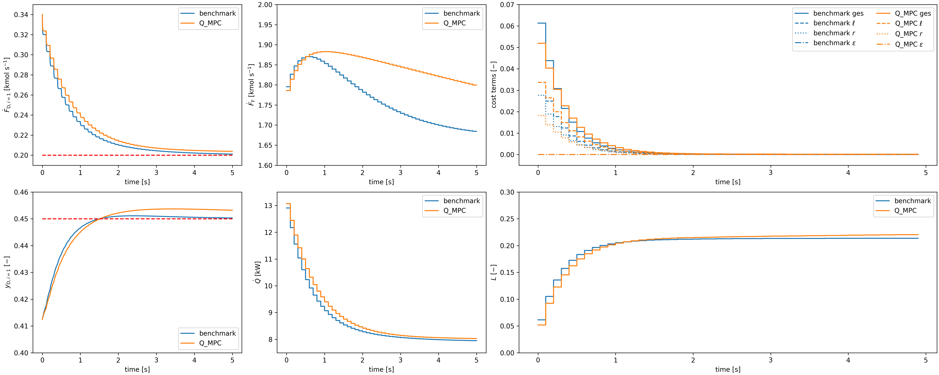
Effect of training (0 epochs)

Slide 22
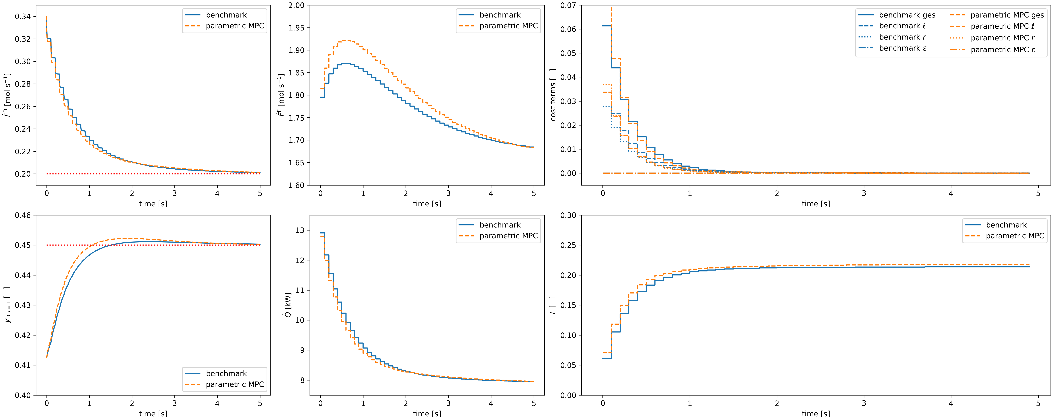
Effect of training (100 epochs)

Slide 23
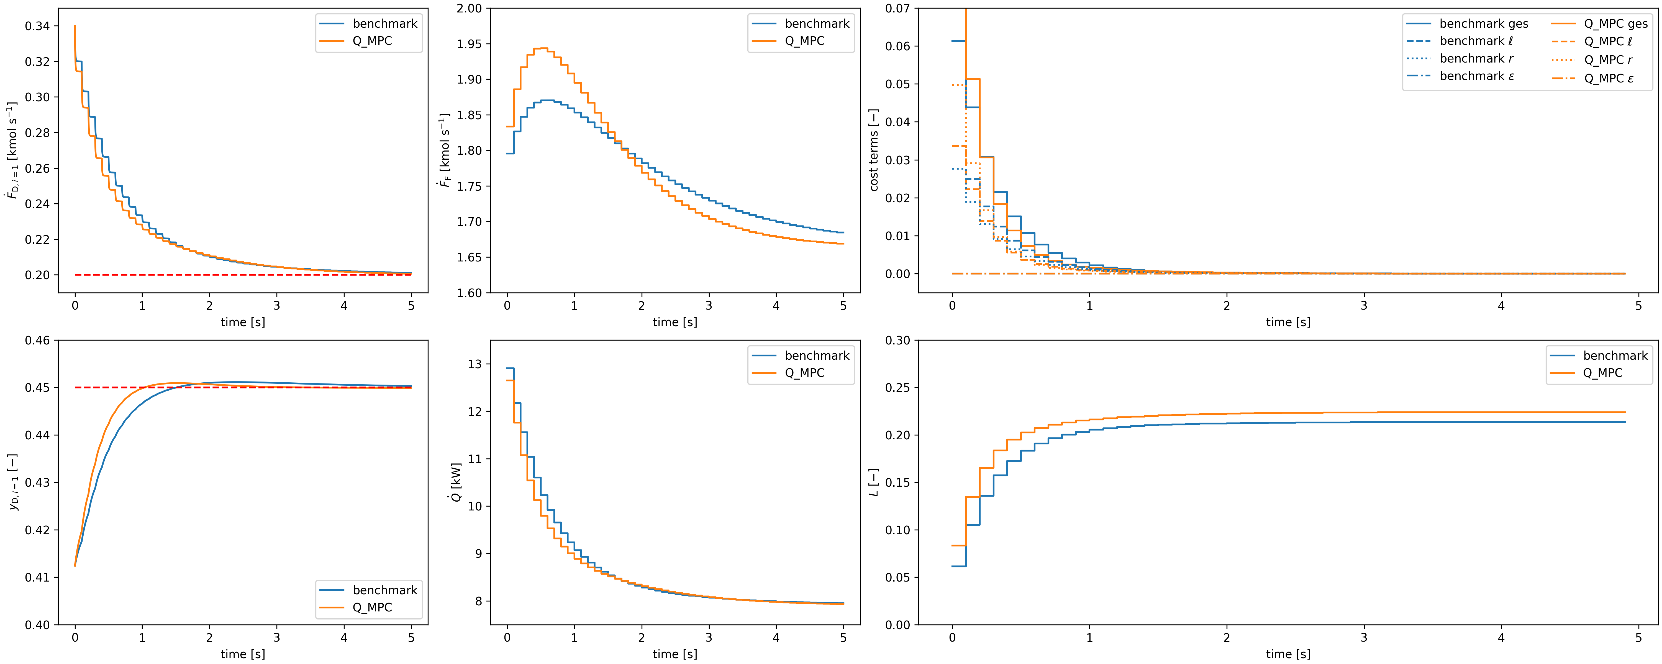
Effect of further training (330 epochs)

Slide 24
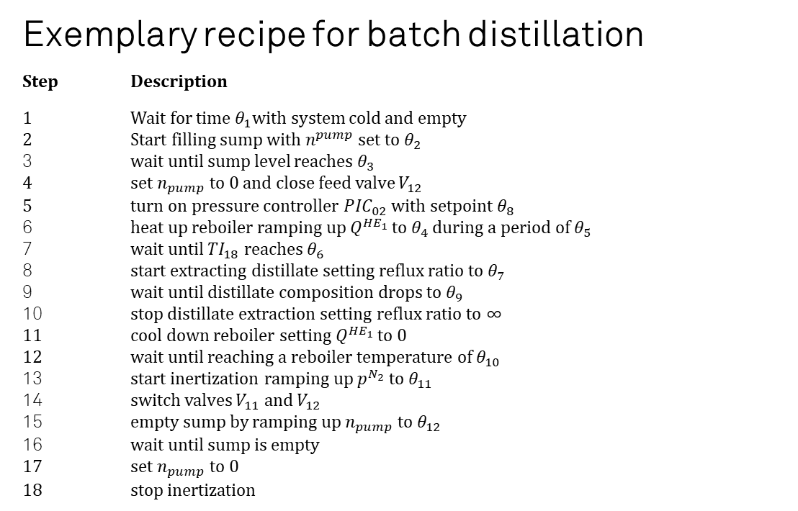
Exemplary recipe for batch distillation
Step Description
1 Wait for time $θ_{1}$with system cold and empty 2 Start filling sump with $n^{pump}$ set to $θ_{2}$ 3 wait until sump level reaches $θ_{3}$ 4 set $n_{pump}$ to $0$and close feed valve $V_{12}$ 5 turn on pressure controller ${PIC}_{02}$ with setpoint $θ_{8}$ 6 heat up reboiler ramping up $Q^{{HE}_{1}}$ to $θ_{4}$ during a period of $θ_{5}$ 7 wait until ${TI}_{18}$ reaches $θ_{6}$ 8 start extracting distillate setting reflux ratio to $θ_{7}$ 9 wait until distillate composition drops to $θ_{9}$ 10 stop distillate extraction setting reflux ratio to ∞ 11 cool down reboiler setting $Q^{{HE}_{1}}$ to $0$ 12 wait until reaching a reboiler temperature of $θ_{10}$ 13 start inertization ramping up $p^{N_{2}}$ to $θ_{11}$ 14 switch valves $V_{11}$ and $V_{12}$ 15 empty sump by ramping up $n_{pump}$ to $θ_{12}$ 16 wait until sump is empty 17 set $n_{pump}$ to $0$ 18 stop inertization

Slide 25
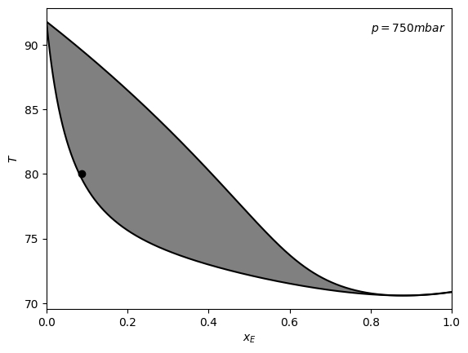
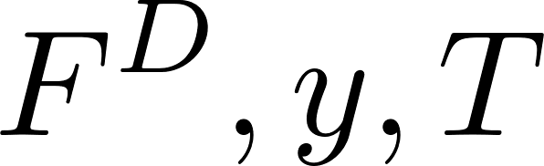
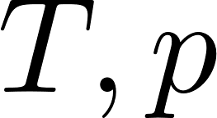
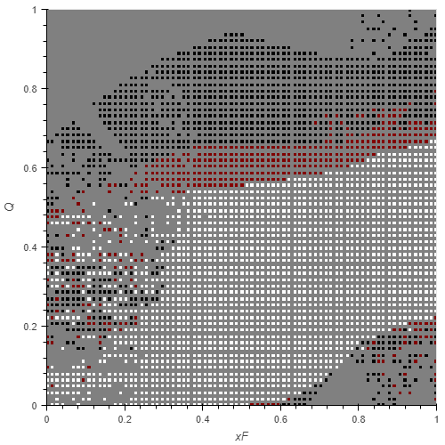
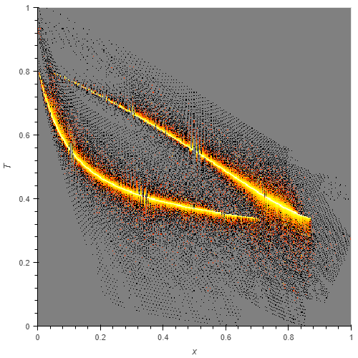
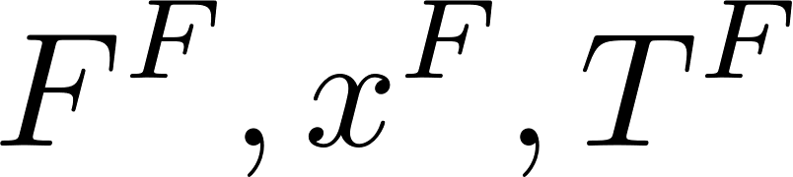
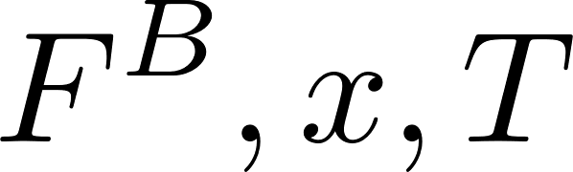
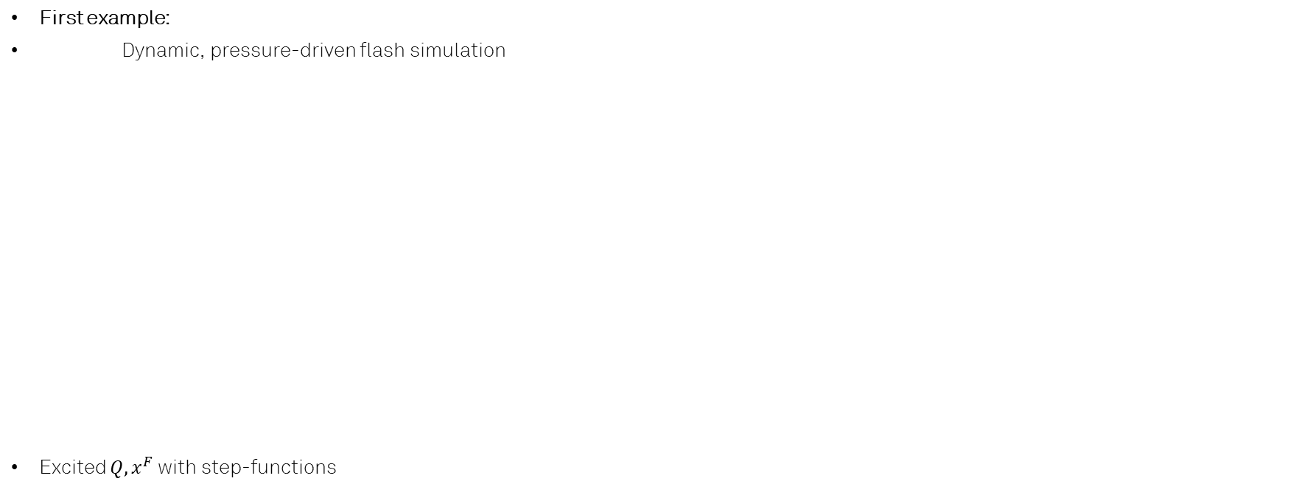
Difficulties of data-generation for surrogate models
First example:
Dynamic, pressure-driven flash simulation
Excited $Q, x^{F}$ with step-functions

